Slide 1
Pretty Object
Unity asset by Amit
@nerdhead

Slide 2
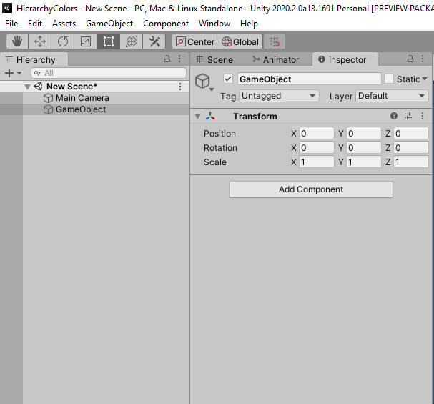
Select your object and click add component

Slide 3
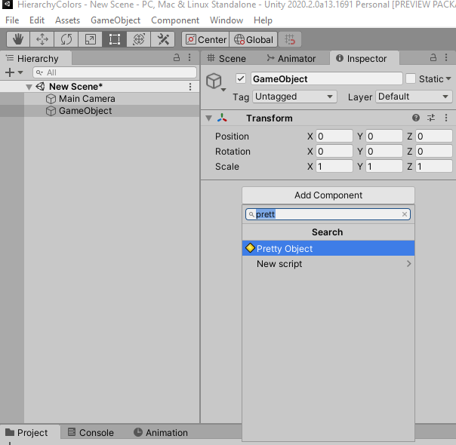
Look for ‘Pretty Object’ and add the component
You can also find it under
Pretty Objects -> Pretty Object

Slide 4
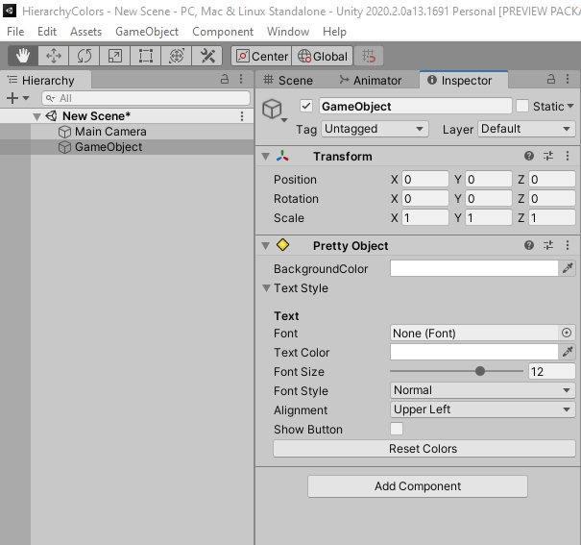
Change the background color of the object
All the text font, size and more
Reset colors to default

Slide 5
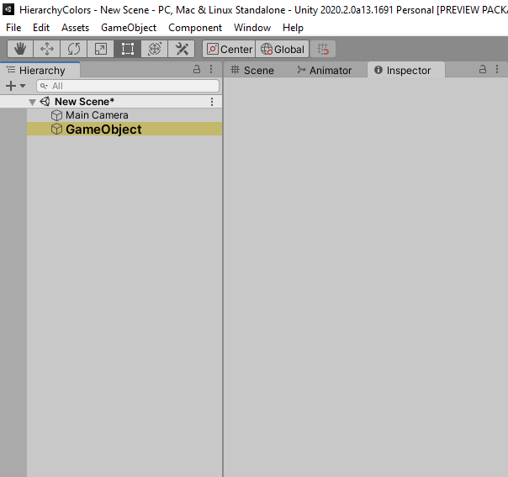
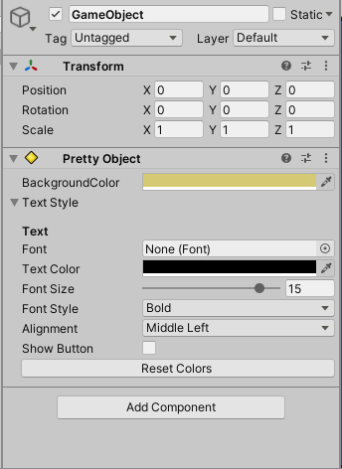
Deselect the object to see the results
The setting used

